Slide 1
use perl or die;
Stefan Seifert
Notes:
Richard Jelinek

Slide 2
CiderWebmail
http://www.ciderwebmail.org

Slide 3
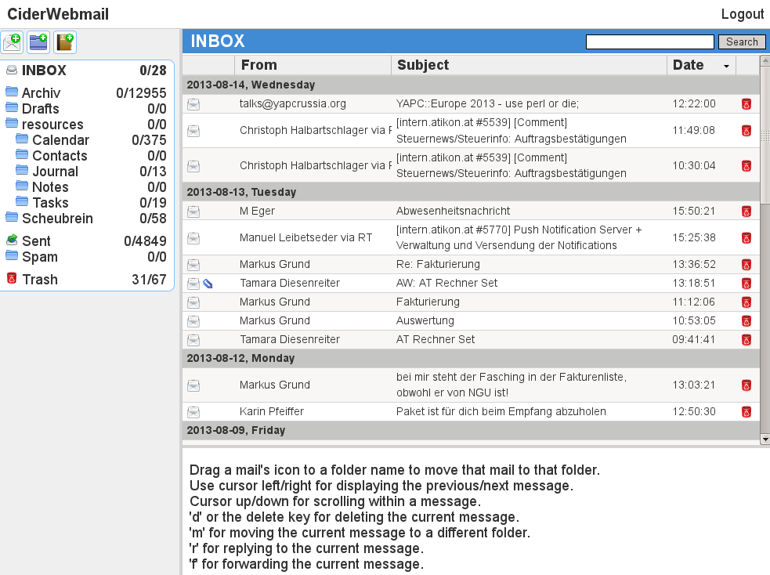

Slide 4


Slide 5
CiderCMS
http://www.cidercms.org

Slide 6
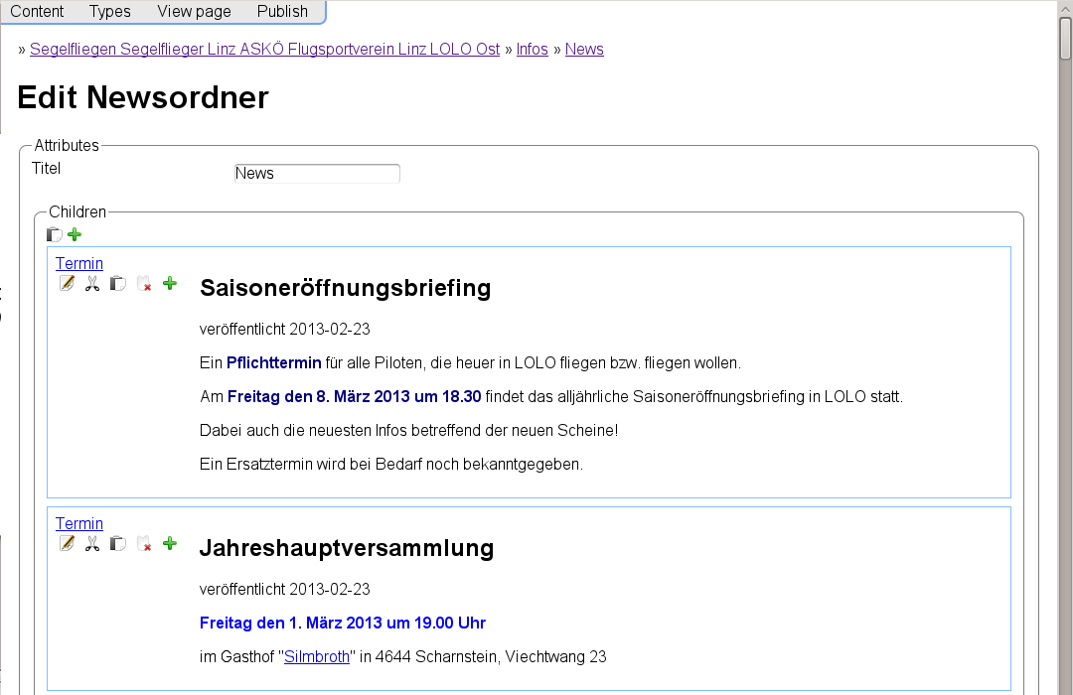

Slide 7
<unnamed> mailing list manager
Future: CiderWebstats?

Slide 8
http://www.ciderwebmail.org
http://www.cidercms.org

